Slide 1
E-POLICE RECORD MANAGEMENT SYETEM

Slide 2
PRESENTED BY:-
JUVERIA WELDER
YUSRA MIRZA
ARBAZ KHAN
SHAHNOOR BAGA

Slide 3
1.0 INTRODUCTION
The project titled “E-Police Record Management System” has been developed for Police department.
E-Police Record Management System project’s main idea is to implement a web application to provide total computerized information system support for different police departments.
E-POLICE RECORD MANAGEMENT SYSTEM will definitely help the police system in making the police work more efficient through equipping the police with modern solutions.

Slide 4
1.1 AIM
To provide customized solutions for the police department which will help eradicate the use of paper and pen to record criminal details, eliminate data redundancy and to improve the efficiency of police procedures.

Slide 5

2.0 EXISTING SYSTEM
The police department currently uses pen and paper based system and there is no system at present in use in the department. In the existing system, it is difficult to maintain the records, databases, as there is no use of technology. It becomes very difficult to circulate the information from one police station to another, which results in missing a lead while solving a case and hence the lack of communication badly affects the co-ordination.
Fig 2.0.1: Depiction of Pen-Paper Based System

Slide 6
2.1 MAJOR DRAWBACKS OF EXISTING SYSTEM
Requires more man power.
The existing system is very time consuming.
Lack of Security.
The existing system is handled manually without the touch of technology a large system becomes outdated.
Since the records are handled manually. It becomes very difficult to circulate the information from one police station to another, which results in missing a lead while solving a case and hence the lack of communication badly affects the co-ordination.
In the existing system, it is difficult to maintain the records, databases, as there is no use of technology.

Slide 7
3.0 PROPOSED SYSTEM
The best and the most effective solution to the problem at hand is to develop an integrated system.
E-police Record Management System is an electronic platform which is capable of maintaining the records of crime like FIR, criminals’ details and police department administration.
It will be helpful in matters of searching, inserting and deleting and using effective data mining tools in order to generate accurate reports.

Slide 8
4.0 SDLC MODEL
The Systems Development Life Cycle (SDLC), also referred to as the application development life-cycle, is a term used in systems engineering, information systems and software engineering to describe a process for planning, creating, testing, and deploying an information system.

Slide 9
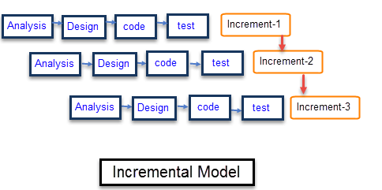
Fig 4.0.1: Incremental Model

Slide 10
We plan to use the conventional prototyping model for the development of our project. The steps we will follow are: 1) Requirement Analysis Requirement and specification of the software are collected. We first discussed at length, about their exact expectations from the software system which enabled us to determine their requirements. 2) Design Some high-end function are designed during this stage.When requirements are known, a preliminary design for the system is created. It is not a detailed design and includes only the important aspects of the system, which gives an idea of the system to the user. 3) Coding Coding of software is done during this stage. The design should be translated into machine readable form. 4) Testing Testing phase ensures that the software is developed as per the users requirements. The project focuses on logical internals of the software and functional externals.

Slide 11

5.0 IMPLEMENTATION TOOLS
5.1 FRONT END
5.1.1 Microsoft ASP.NET
Fig. 5.1.1.1 ASP.NET Logo

Slide 12
ASP.NET is an open-source server-side web application framework designed for web development to produce dynamic web pages. It was developed by Microsoft to allow programmers to build dynamic web sites, web applications and web services.
ADVANTAGES :
It reduces the amount of code required for building large and complex applications.
Thus, increases overall development speed and reduce development costs.
Just-in-time compilation, smart caching technologies and native optimization dramatically increase overall application performance.
ASP.NET Framework supports varied languages; it allows you to select the language that better applies to your application.
ASP.NET provides ability of cross platform migration.

Slide 13

5.2 BACK END 5.2.1 Microsoft SQL Server
Fig. 6.2.1.1 MS SQL Server Logo

Slide 14
Microsoft SQL Server is comprehensive, integrated data management and analysis software that enables organizations to reliably gain greater insight from their business information and achieve faster results for a competitive advantage Key Capabilities 1) High Availability: Ensure business continuity with the highest levels of system availability through technologies that protect your data against costly human errors and minimize disaster recovery downtime. 2)Performance and Scalability: Deliver an infrastructure that can grow with your business and has a proven record in handling today's large amounts of data and most critical enterprise workloads. 3) Security: Provide a secure environment to address privacy and compliance requirements with built-in features that protect your data against unauthorized access. 4) Developer Productivity: Build and deploy critical business-ready applications more quickly by improving developer productivity and reducing project life cycle times.

Slide 15
6.0 SYSTEM REQUIREMENTS
5.1 Hardware requirements
Intel Pentium III Processor or above with 1GHZ
At least 512MB of RAM (Recommended 1GB)
LAN Card.
Recommended 1024x768 resolution.
5.2 Software requirements
Windows 7,8,10 32-bit and 64-bit
Windows XP, 32-bit, and 64-bit
.NET Framework
SQL server 2005

Slide 16
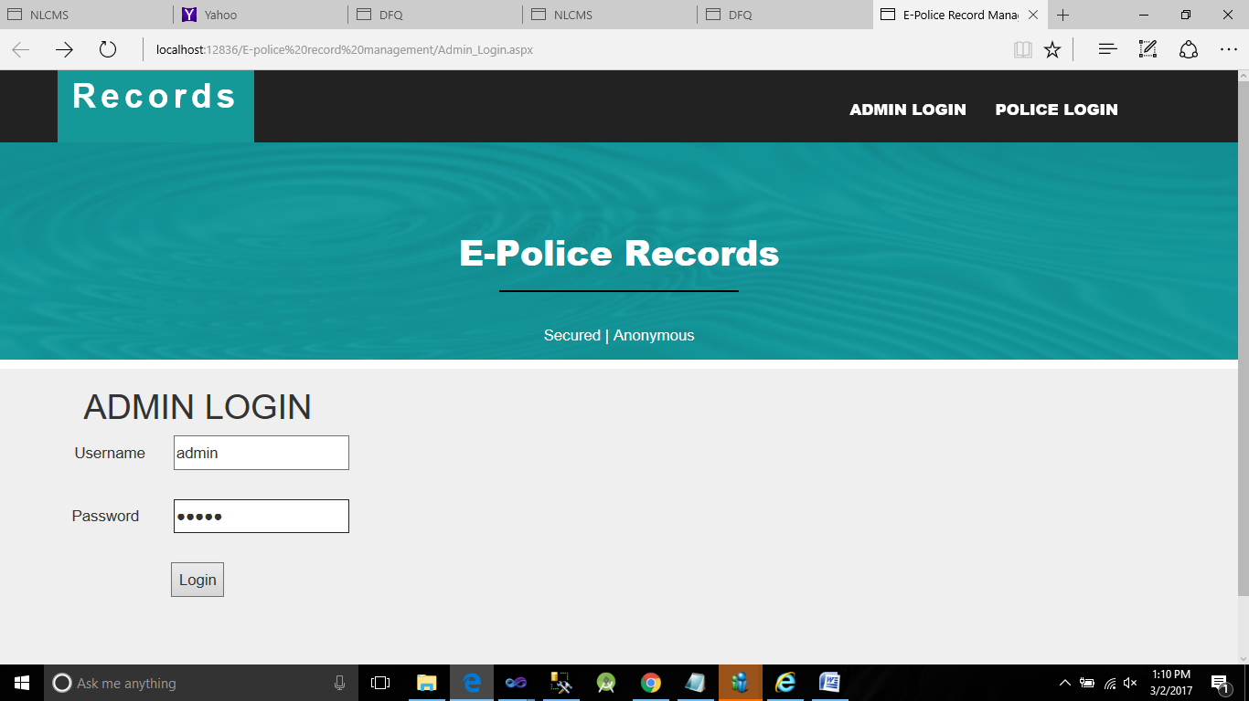
7.0 SCREENSHOTS
Fig 7.0.1 Homepage

Slide 17
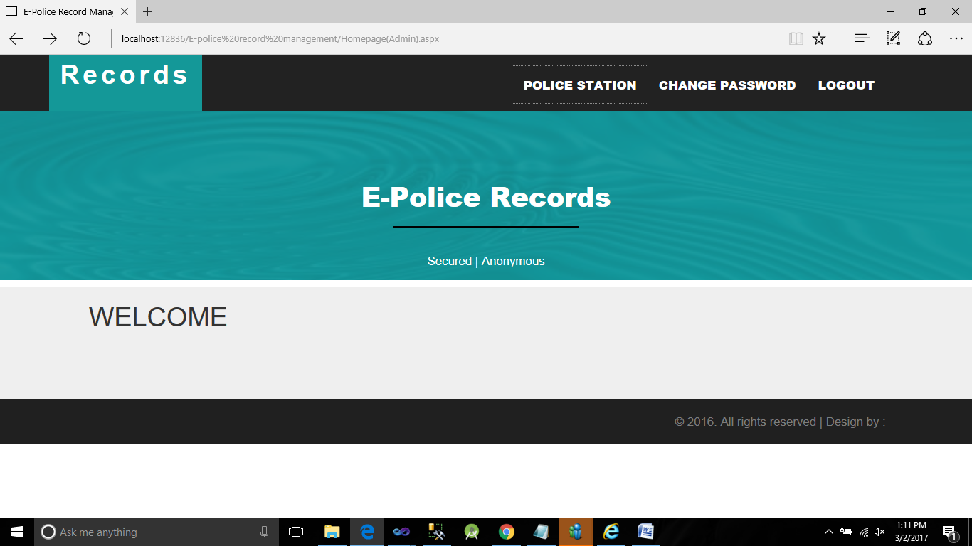
Fig 7.0.2 Admin page

Slide 18
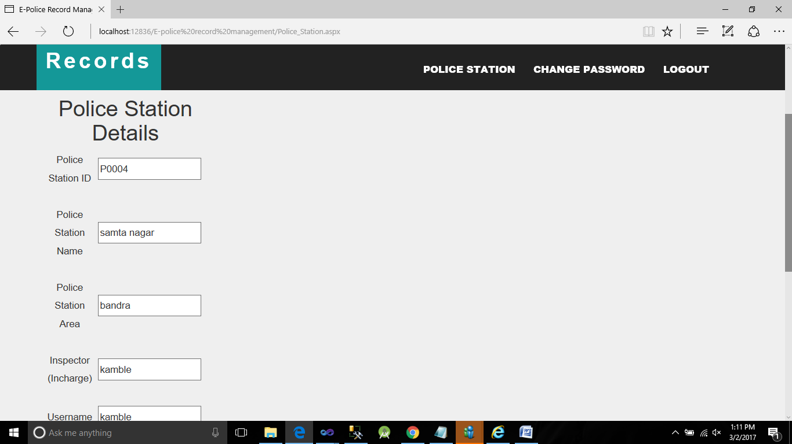
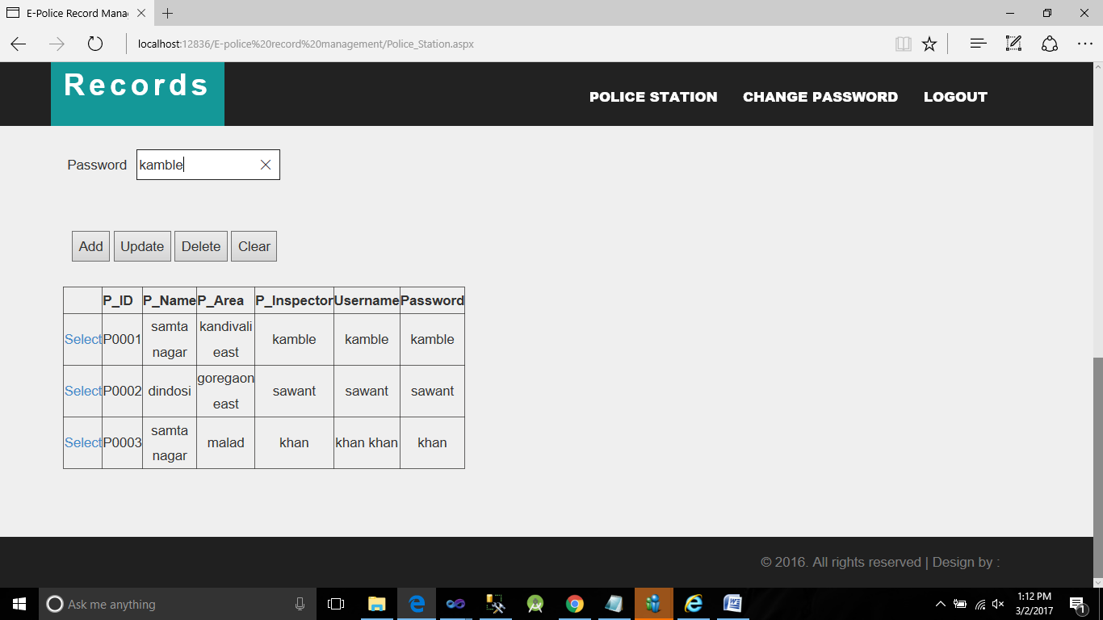
Fig 7.0.3: Adding Police Station
Fig 7.0.4 Police Station Details

Slide 19
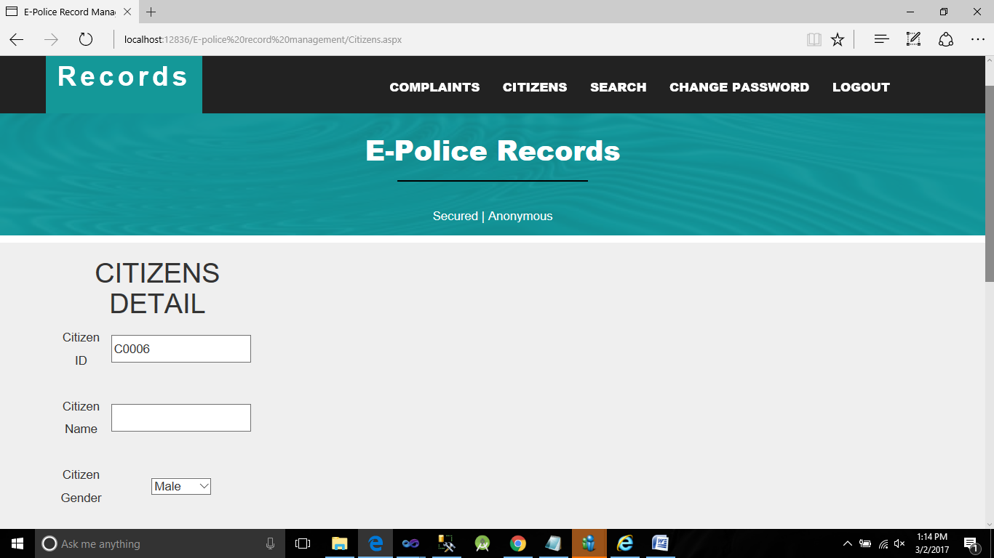
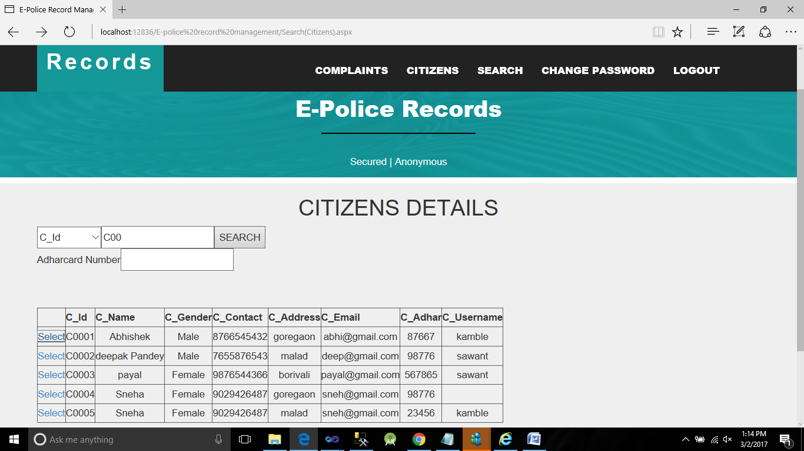
Fig 7.0.5: Adding Citizens Detail
Fig 7.0.6 Citizen Details

Slide 20
8.0 CONCLUSION
This project “E-POLICE RECORD MANAGEMENT SYSTEM” will definitely help the police system in making the police work more efficient through equipping the police with modern solutions. It aims to ensure solutions and means for the police officers that support their main activity and it will be interesting for the audience in the context of law and order situation in our country. The main intent of this project is to upgrade the developing countries police administration to the world standard by using modern Information and Communication Technologies. At last, we recommend to developing countries that to take necessary steps for upgrading the present police system to E-police system by overcoming the issues and challenges. In future, we can add and use new technologies, wireless communication systems, modern IP networks etc.

Slide 21
9.0 BIBLIOGRAPHY
For the development of this project, we referred the following books and websites:
BOOKS
ASP.NET- The Complete Reference
Author- Matthew MacDonald
Microsoft SQL Server 2005
Author-Jeffrey Shapiro
WEBSITES
http://documents.tips/documents/e-police-police-record-management-system.html
https://en.wikipedia.org/wiki/Police_IT
http://www.ijritcc.org/download/E-Police%20Police%20Record%20Management%20System.pdf

Slide 22
ANY QUESTIONS???

Slide 23
THANK YOU!!!

